Slide 1
Spring Boot Application Case Study
Technology Used : Java 8 , Spring Boot , Spring REST , Spring Data JPA , MySQL Database , Micro services , Eureka Server & Client

Slide 2
Background
ABC-University wants to provide the quiz application to the students , so that Student can practice and learn.
Students can give test on various category (based on their choice) and select the level of difficulty (basic , intermediate & advance).
Each test should consist 20 questions from the same difficulty level.
Students after submission of test , will get the result in % and can see that how many (count) participants scored more and less marks than him and maximum marks scored.
Students can see their historic data as well.
Whole process can only be possible after valid login.

Slide 3
Continue.
This data can also be accessed by the university
University admin filter students records based on category and difficulty level.
Admin can sort the student records too based on above criteria.

Slide 4
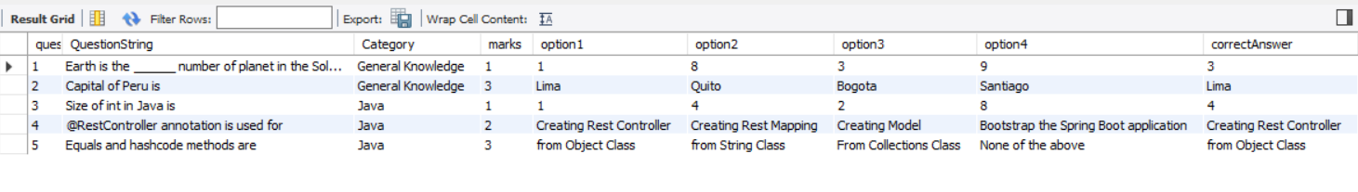
Sample Data of Question Table
The above table is the sample unit of Question table
Column marks is used to identify the difficulty level.
QuestionID* is an int value.
first column

Slide 5
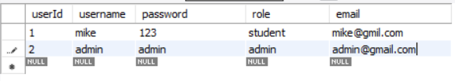
Sample Data – User Table

Slide 6
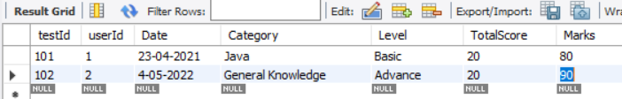
Test-Score Table
Test score table is used to store the test records.
It holds User (Student) Id and TestId (act as each attempt).
Notice marks is calculated out of 20 in percentage basis.
first column

Slide 7
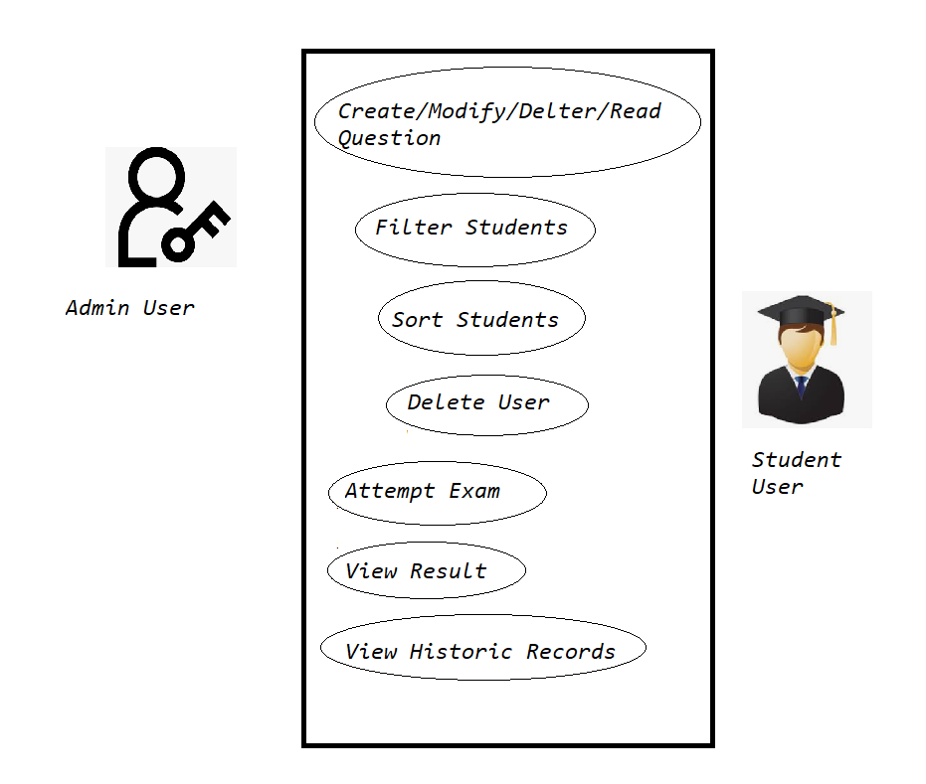
Use Case

Slide 8
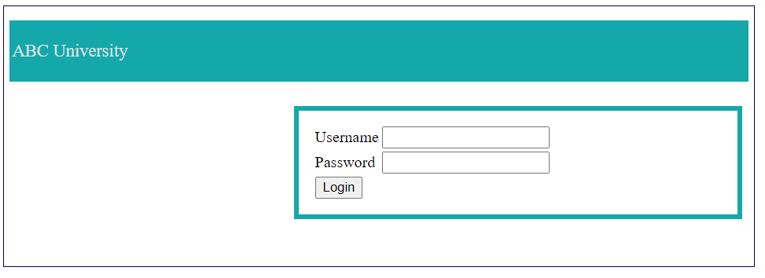
Angular Front End
Create Angular front end

Slide 9
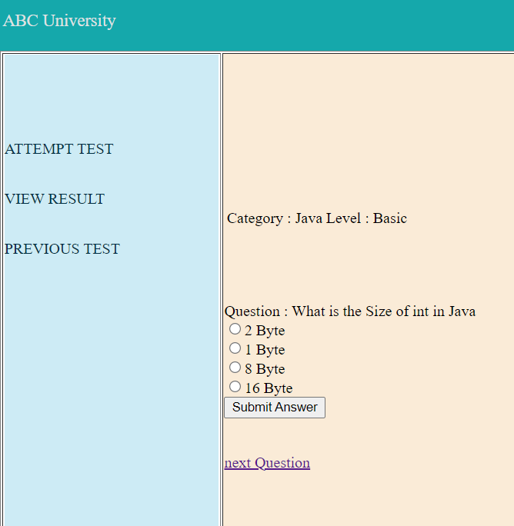
User – Student Test page
Attempt test , view result & previous test are the use cases which student can perform.

Slide 10
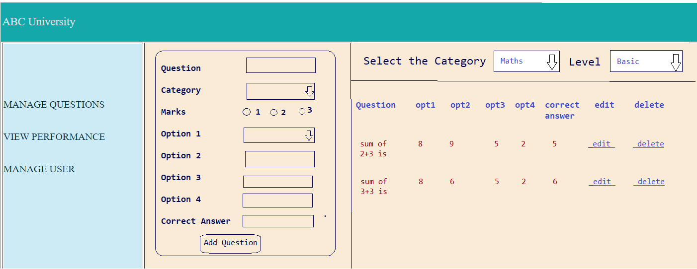
Front end for User-Admin console
Admin user can manage questions (CURD operation), view performance & mange user

Slide 11
Work opportunity
Based on the previous sample of front end , create other front end pages.
Write good quality code.
Write Spring code in modular approach .
Write Java Test cases using Junit testing.
Write proper documentation of the code.

